Slide 1
Cricket Score Prediction
By
Samir Chakravarthy F

Slide 2
Objective and Interest
Objective: To develop a machine learning model for predicting cricket scores.
Interest: My interest in cricket is sky level high. I used to watch cricket and analyze where my favorite Team made a mistake or made the correct decision. So, I have chosen this project.

Slide 3
Problem Statement
To develop a cricket score prediction system that can accurately forecast the total runs a Team is likely to score in a limited-overs cricket match based on historical data, current match conditions, and player performance metrics. The system should consider various factors, such as the runs scored in the last 5 overs, wickets that fell in the last 5 overs, etc. to provide a reliable prediction of the Team's final score.
Create a predictive model to estimate the total runs a cricket Team is expected to score in a given match.
The cricket score prediction system aims to enhance the enjoyment and engagement of cricket fans by offering them a valuable tool for making informed predictions about match outcomes and providing a deeper understanding of the game.

Slide 4
Key Performance Indicators (KPI)
I have used the key metrics to evaluate the model's performance in my project is R-Squared Value

Slide 5
Data Collection
Data Sources: Kaggle: https://raw.githubusercontent.com/zepanalytics/IPLScorePredictor/main/ipl_data.csv
Data Preprocessing: Data cleaning, Handling missing values, Visualization, and Encoding categorical variables.

Slide 6
Model Development
Machine Learning Algorithm: Linear Regression, Random Forest, XG Boost, Decision tree, K-Nearest neighbor.
Training and Testing: Splitting the data into 20-80 ratios for testing and training.
Best Dataset: After evaluating all the datasets, we found that “Random Forest” has the best accuracy score

Slide 7
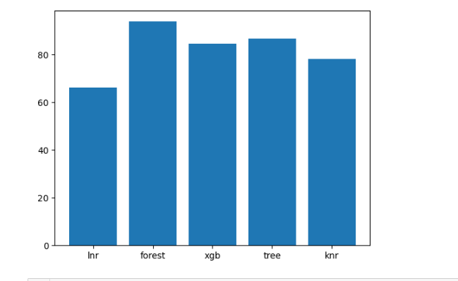
Comparing the best Algorithm

Slide 8
Result
Visualization: After taking the inputs from the dataset, the result is:
Actual Score Predicted score
Test 1: 148 147
Test 2: 176 187
Test 3: 165 161

Slide 9


